Slide 1
AP Statistics Section 7.2 DISCRETE Random Variables

Slide 2
Mean and Std Deviations of Discrete Random Variables:
Most questions involving “discrete random variables” will also have a probability distribution for each value of the random variable:
Suppose you are playing a game rolling a bias die. The top row is the discrete random variable for the outcome of a single roll.
The second row is the probability of getting each roll
Random Var. “X” is the outcome of the roll
Probability of each outcome. Make sure the sum is equal to 100%
Q1: How do you find the “Mean” value of “X”
The mean of the discrete random variable “x” is also known as the “EXPECTED Value”
The best way to find the “mean” or “expected value” is the use your Ti83. Type the Rand. Var “X” into L1. Then type the probability distributions into L2. Then perform a 1-Variable Calculation L1, L2 to get the mean

Slide 3
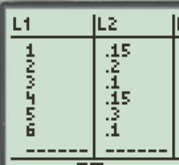

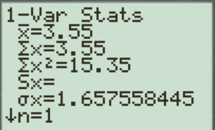
Mean and Std Deviations of Discrete Random Variables:
Q2: How do you find the “standard deviation” of “X”
The standard deviation of the discrete random variable “x” is given by this formula:
Mean: 3.55
Std Dev: 1.657558
The quickest way to find the standard deviation of the random variable “x” is to use your Ti83

Slide 4
Expected Value (mean) and Standard Deviation:
Q: How do you interpret the Expected Value and standard deviation?
The expected value (mean) of a discrete random variable does not have to be a whole number! ie: E(x) = 3.55
The expected value is the average of the outcomes when you perform many many many trials of the activity.
Ie: Suppose you play a game with an expected value of 2.55. This means that on average, you expect to win 2.55 for each time you play this game
The standard deviation is an indication of how much your outcomes deviates from the mean
a large standard deviation means that there is a lot of variability for the random variable, outcomes are less predictable
On average, each trial will deviate from your mean E(x) by 2.55

Slide 5
Ex: Dice Game
Suppose it cost $5 to play a game where you roll a die once. The payoff for each outcome is as follow:
a) Define is your random variable “x” and create a probability distribution for the random variable.
b) Find the expected value (μ_{x}), standard deviation (), and variance (²) of the random variable
c) In context, what does the expected value and std dev. tell you?
d) Suppose you Roll a die 20 times and recorded each outcome. Calculate your payout after 20 rolls. What is the mean and std dev. for the of the payout after 20 rolls?
e) Is this game worth playing? Explain
f) What is the probability that you will be winning after 20 games?

Slide 6
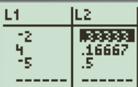
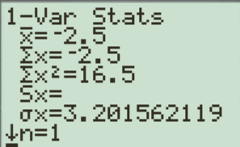
1. Your random variable “x” is how much money you will win.
c) To determine if this game is worth playing, we refer to the “expected value”, which is -2.5. In the long run, on average you will lose $2.50 per game. If you play this game 20 times, you will expect to lose $50.00.
the standard deviation of approximately $3.20156 measures the amount of variability in the possible outcomes over a single play of the game. On average, a single outcome will be about $3.20 from the mean outcome of -$2.5.
If you play this game 20 times, the standard deviation will be:

Slide 7
Q: Is this game worth playing?
Absolutely NO..
Q: What is the probability that you will be winning after 20 games?
It is very unlikely that you will be winning any money after 20 games
The probability of winning any money after 20 games will be very close to zero
NOTE: IT is possible to assume that the distribution of how much you win is a normal distribution because of the CENTRAL Limit Theorem. This will be discussed in CH9.

Slide 8
Ex: Suppose there are independent two spinners with the following output. Spinner “X” has outputs of 1, 2, or 5. Spinner “Y” has outputs of 2 or 4. The probability distributions are given:
a) Calculate the “mean” and “std dev” of each discrete random variable “x” and “y”
b) Complete the probability distribution for the sum of “X + Y”
c) What is the mean and standard deviation of “X + Y”
d) Use the rules for combining random variables to check your results in “c”
e) Suppose you spin each spinner 10 times, what is the probability that the sum of all the spins is 50 or more?

Slide 9
Expected Values for Two random variables Activity: 7C read p492-493
Given the distribution of “X” and “Y”
From this activity we see that:

Slide 10
e) Suppose you spin each spinner 10 times, what is the probability that the sum of all the spins is 50 or more?
If we spin each spinner 10 times, the expected value (mean) of the distribution of sum is equal to:
Again, we would assume that the distribution of sums of the flips to be normally distributed because of the Central Limit Thm (Ch9)
There’s a70% chance that the sum of all the spins will be 50 or more.

Slide 11
Linear Transformations with Random Variables
OR suppose you have the mean/SD of two different items that you are measuring and you want to combine them
To find the mean/SD of the sum of the two items will also require a linear transformation
If X and Y are random variables then:
Mean
Variance: Only if X & Y
are independent
Variance: X & Y are dependent.
“p” is the correlation between X and Y (Advanced)

Slide 12
Ex: Let “X” represent the sum of two dice
a) Define the random variable “X” in this situation
b) Is it a continuous or discrete random variable?
c) Find the mean and standard dev. of the random variable “x”
d) Interpret the value of the expected value?
e) Draw the density curve (ie: probability distribution)
f) If someone rolled the die 5 times and got a pair of 6 every time, would you be surprised? Explain:
a) Random Variable “X” is the sum from rolling two dice
“X” is discrete because it can only take on integers from 2 to 12

Slide 13
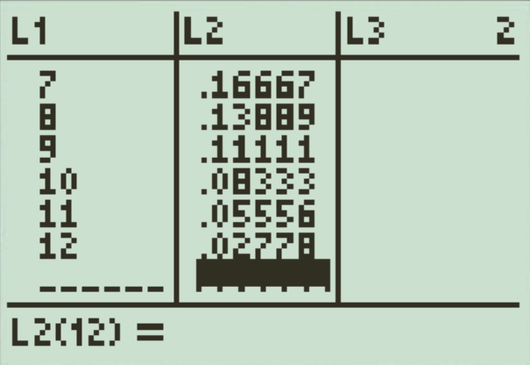
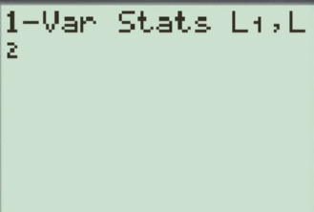
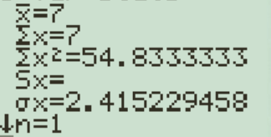
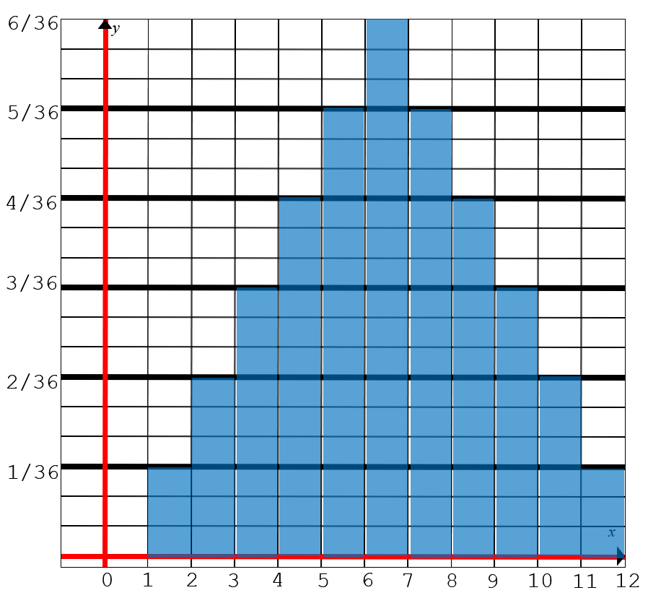
List the value of “X” into L1 and the corresponding probabilities in L2
Note: Notice that the mean and sum are the same!
Mean: 7
Std Dev: 2.415
A mean (expected value) of 7 indicates that the average sum of each roll is 7
A standard dev. of 2.415 means that the sum of each roll will on average deviate from 7 by 2.415
Around 68% of the sums will be between 4.585 to 9.415
e) Draw the probability distribution
The prob. Of rolling a pair of 6 five times in a row would be:
Yes I would be surprised if someone rolled a pair of 6 five times in a row b/c the chances of that happening is very low, less than 1 in 60million

Slide 14
Ex: The probabilities that a patient will have 0, 1, 2, or 3 medical tests performed upon entering a hospital are 6/15, 5/15, 3/15, and 1/15, respectively.
(a) Identify the random variable of interest (Y) What values does Y take?
(b) Make a table that gives the probability distribution of Y.
c) Choose a patient entering a hospital at random. Express “the chance of the patient having more than 1 medical test” in terms of Y.
(c) What is P(1 < Y ≤ 3)?
(d) What is P(Y ≠ 2)?
e) What is the expected value and std Dev. of “Y”
f) In context, what does the expected value and std dev. tell you?
g) Suppose you work at a hospital and 15 patients arrive. What is that probability that there will be 20 or more tests will be done with these patients?

Slide 15
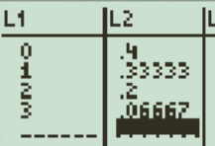
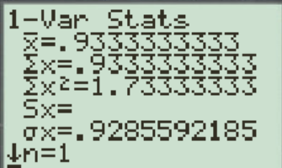
a) Y = The number of medical tests performed on a patient when entering hospital
Y takes on values 0, 1, 2, 3
The probability that a randomly chosen patient will have more than one medical test is 4/15
The prob. that a patient chosen randomly will have 0, 1, or 3 tests is 80%
In context, a random patient coming in will receive an average of 0.93 medical tests performed on them

Slide 16
The average is 0.93333.. The expected number of tests that a randomly chosen patient will receive is 0.93333 medical tests.
A standard deviation of 0.929 suggests that around 68% of patients will receive $0.93333±0.929$tests
g) Suppose you work at a hospital and 15 patients arrive. What is that probability that there will be 20 or more tests will be done with these patients?
Mean Number of tests for 15 patients:
Variance & std dev. of # of tests for 15 patients
Probability of having 20 or more tests

Slide 17
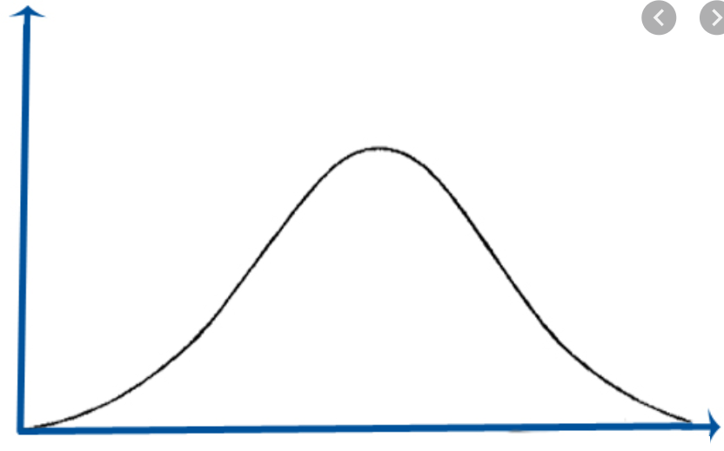
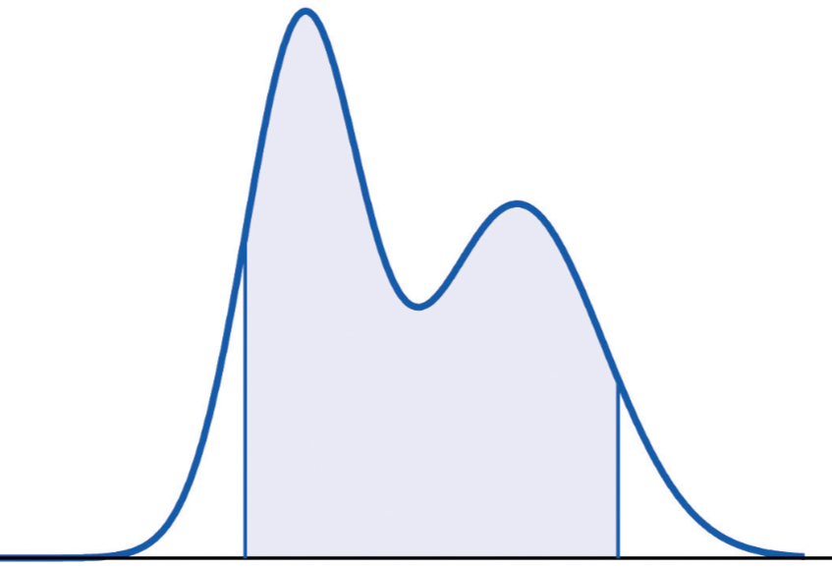
Continuous Random Variables:
For continuous random variables, the probability distribution is described by a density curve
Suppose you are looking for the probability of a single event in a CRV, the probability will be equal to zero!
The mean, (μ_{x}) is the center of a symmetrical density curve
SD is usually given
Normal curve, use what you learnt in Ch2!!

Slide 18
CONTINUOUS Random Variables
Ex: A SRS of 500 Canadian adults is asked what they think is the most serious problem facing our schools. Suppose that in fact 30% of all adults would answer “bullying” if asked this question. The proportion of the sample who answered “bullying” will vary in repeated sampling. In fact, we can assign probabilities to values of using the normal density curve with mean 0.3 and standard deviation 0.03.
a) What is the probability that at least 32% of the sample believes that “bullying” is the most serious problems in schools
b) What is the probability that less than 25% of the sample believes that “bullying” is the most serious problem in schools
c) What is the probability that between 25% and 32% of the sample believes that “bullying” is the most serious problem in schools

Slide 19
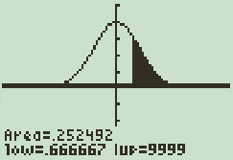
Use the normal probability distribution to solve the following:
We can also normalize the values:
There is a 25.25% chance
that atleast 32% of the sample
taken will believe that
‘bullying” is the most serious problem facing our schools

Slide 20
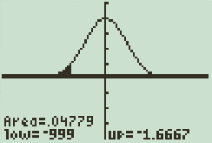
We can also normalize the values:
There is a 4.78% chance that less than 25% of the sample taken will believe that ‘bullying” is the most serious problem facing our schools

Slide 21

Big Six Wheel:
Money wheel[edit]
This variant is the most common in casinos in the United States. The symbols are $1, $2, $5, $10 and $20 bills — and two special symbols, a joker and the casino logo. The $1 bills pay at odds of 1 to 1, the $2 bills at 2 to 1, the $5 bills at 5 to 1, and so on. The joker and the logo pay at odds of 45 to 1
There are 54 slots
Category : ODDs : Payout $20 – 2 / 54 : 1 to 20
$10 – 4/ 54 : 1 to 10
$5 – 8 / 54 : 1 to 5
$2 – 15 / 54 : 1 to 2
$1 – 23 / 54 : 1 to 1
Joker A – 1/54 : 1 to 45
Joker B – 1/54 : 1 to 45
One slot is chosen for each spin
The slot determines which category wins

Slide 23
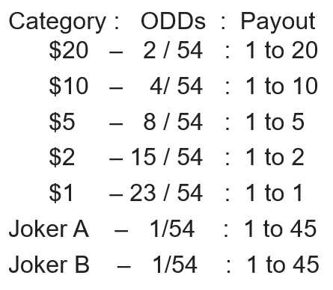
Depending on what you wager on, these are the expected earnings:
Suppose you are playing $1 each game for many games, the expected earning wagering in each of the categories are as follow:
If you only wager on the $20 category, expect to lose $0.22 each game
If you only wager on the $10 category, expect to lose $0.26 each game
If you only wager on the $5 category, expect to lose $0.11 each game
If you only wager on the $2 category, expect to lose $0.17 each game
If you only wager on one Joker category, expect to lose $0.148 each game
If you only wager on the $2 category, expect to lose $0.148 each game

Slide 24
Q: What is the expected outcome if you wage $1 each to the three categories of $5, $2, and $1 each spin?
If it spins $1 you lose $2 b/c of the other two wagers
If it spins $2 you lose $1
If it spins $5 you only win $3
There are 4 other slots left and each of those will lose $8
If you wager three slots of $1, $2, and $5 each spin, then expect to lose $1.13 per game

Slide 26
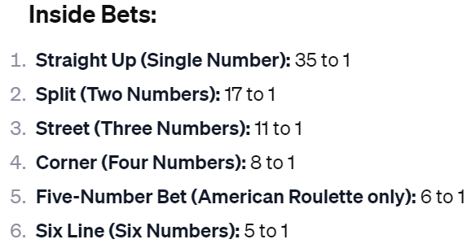
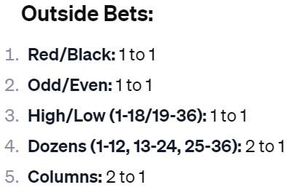
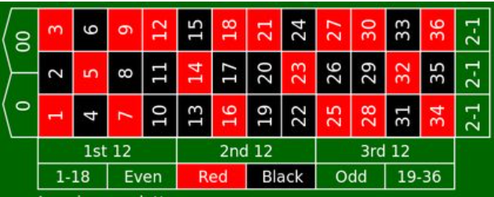

Slide 27
Payout
1 Arrow 1 to 1
2 Arrows 2 to 1
3 Arrows 3 to 1
4 Arrows 4 to 1
5 Arrows 10 to 1
H
A
G
B
F
C
E
D
Q: Suppose you wager $1 each game, what is the expected Value of this game?
Q: What is the standard deviation of this game?
Q: If you played this game 100 times, what is the expected payout?
Q: If you played this game 100 times, what is the probability that you will make money?
SPIN
SPIN

Slide 28
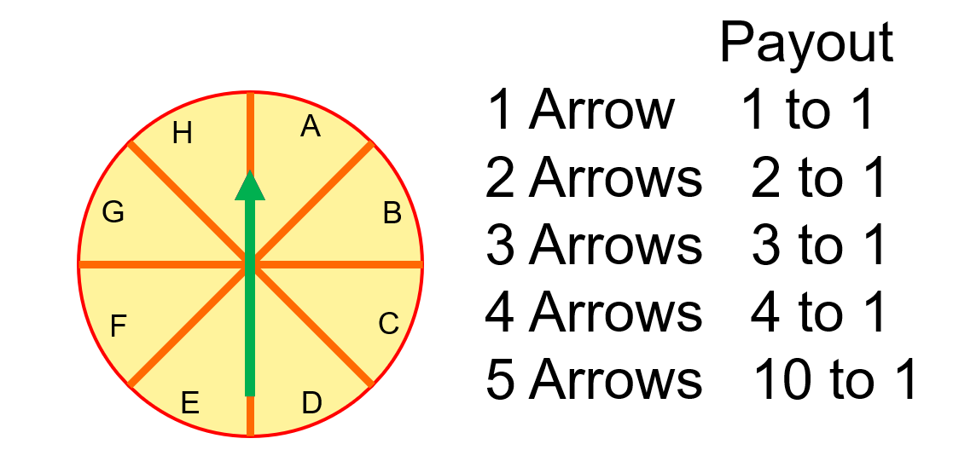
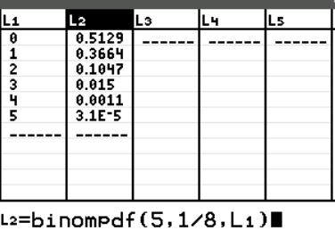

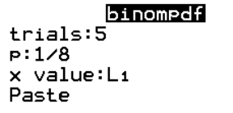
There are 5 arrows, each arrow has 8 spots to land in
Suppose you wager in one of the spots “A”, the probability that you will get any one arrow is 1/8
So each arrow is either hit or miss, which means it is binomial. p = 1/8 and q = 7/8
Use a binomial distribution to get the probability of getting 1 to 5 arrows
5 arrows
How many arrows you get
Use a Ti83 to calculate the expected value:
L3: Payout for each outcome

Slide 29
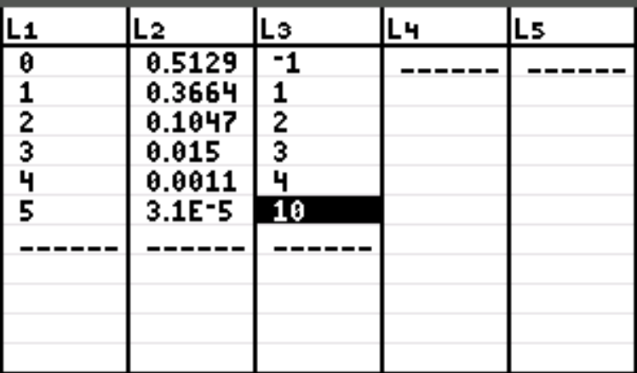
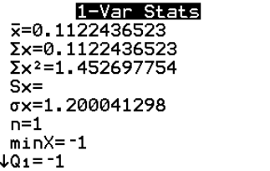
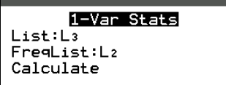
L2: the probability of getting that many arrows
L1: Number of arrows that you land
L3: payout for each outcome, ie: no arrows lose $1, 5 arrows win $10
With this output, we can see that the expected value is $0.112
Each game we play we would win 11 cents
However, with the way we spin the arrows, getting 2 or more arrows to land is less likely!

